Slide 1
Data sources:
Kremer (1993); Piketty (2012)

Slide 2
Data sources:
Kremer (1993); Piketty (2012)

Slide 3
LOG
SCALE
Data sources:
Kremer (1993); Piketty (2012)

Slide 4
LOG
SCALE
Data sources:
Kremer (1993); Piketty (2012)

Slide 7
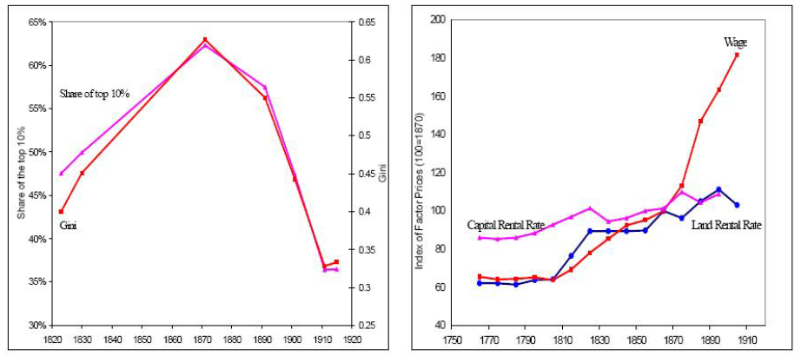
Early Industrial Era
Kuznets curve
Rise of human capital
Source: Galor (2005). Data on England.

Slide 8
Early Digital Era

Slide 9
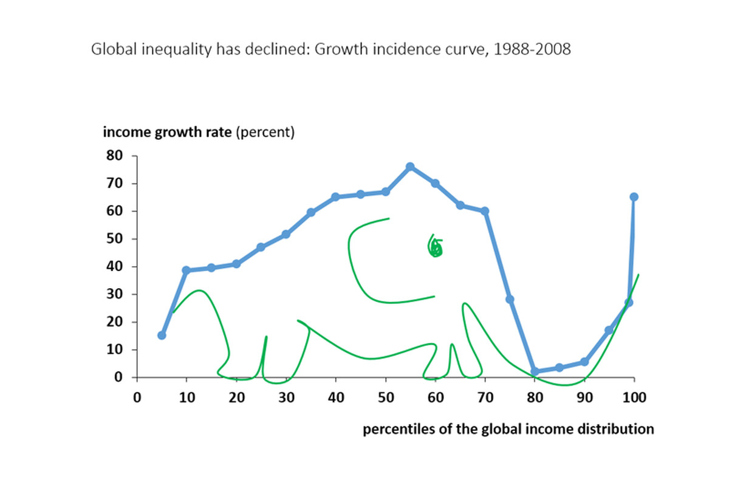
Data from Milanović (2016)

